Slide 1
ietf-ccamp-yang-otn-slicing
GitHub: https://github.com/aguoietf/ietf-ccamp-yang-otn-slicing
Document format
Propose to use Kramdown for easily tracking changes
.txt, .docx versions also uploaded

Slide 2
Issue Tracking
https://github.com/aguoietf/ietf-ccamp-yang-otn-slicing/issues

Slide 3
Proposed Call Schedule
Weekly or Bi-weekly
Candidate time slots
Doodle poll: https://doodle.com/poll/8eb8iabyhx2vewyi
Tue 10-11am EST / 10-11pm China / 4-5pm Europe
Wed 8-10am EST / 8-10pm China / 2-4pm Europe
Thu 9-10am EST/ 9-10pm China / 3-4pm Europe
Fri 8-10am EST / 8-10pm China / 2-4pm Europe

Slide 4
Functional Diagram of OTN-SC
Orchestrator/E2E SC
NSC NBI
IETF-NSC
OTN-SC NBI
OTN-SC
Reference to the other draft
MPI
PNC

Slide 5
OTN-SC Deployment Scenarios
Orchestrator/E2E SC
Orchestrator/E2E SC
Orchestrator/E2E SC
Orchestrator/E2E SC
NSC NBI
NSC NBI
NSC NBI
NSC NBI
IETF-NSC
IETF-NSC
IETF-NSC
IETF-NSC
OTN-SC NBI
OTN-SC NBI
OTN-SC NBI
OTN-SC NBI
OTN-SC
OTN-SC
OTN-SC
OTN-SC
MPI
MPI
MPI
MPI
PNC
PNC
PNC
PNC

Slide 6
Expanded View of OTN-SC
IETF-NSC
NBI
Recursive (OTN-SC),
Multi-domain recursive (MPI)
OTN-SC
NBI
NBI
Non-recursive (OTN-SC),
Multi-domain recursive (MPI)
OTN-SC
OTN-SC
MPI
MPI
Non-recursive,
Single domain
L-MDSC
PNC
MPI
MPI
PNC
PNC
Notes:
Use case 1 : realization of IETF NSC at optical layer
Use case 2 : realization of IETF NSC is to use existing OTN slices to

Slide 7
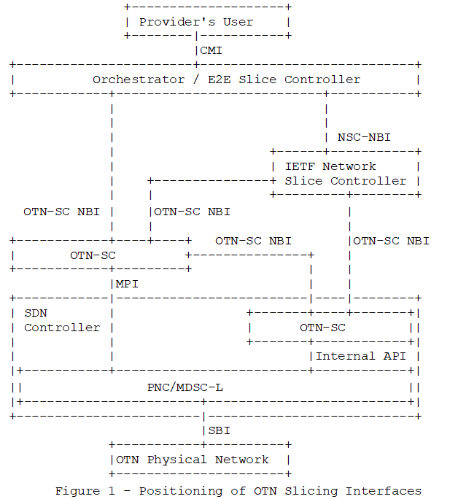
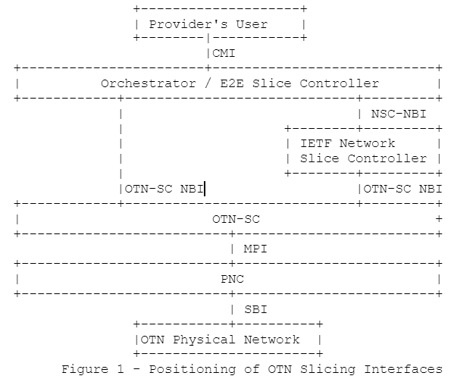
OTN-SC Figure Update

Slide 8
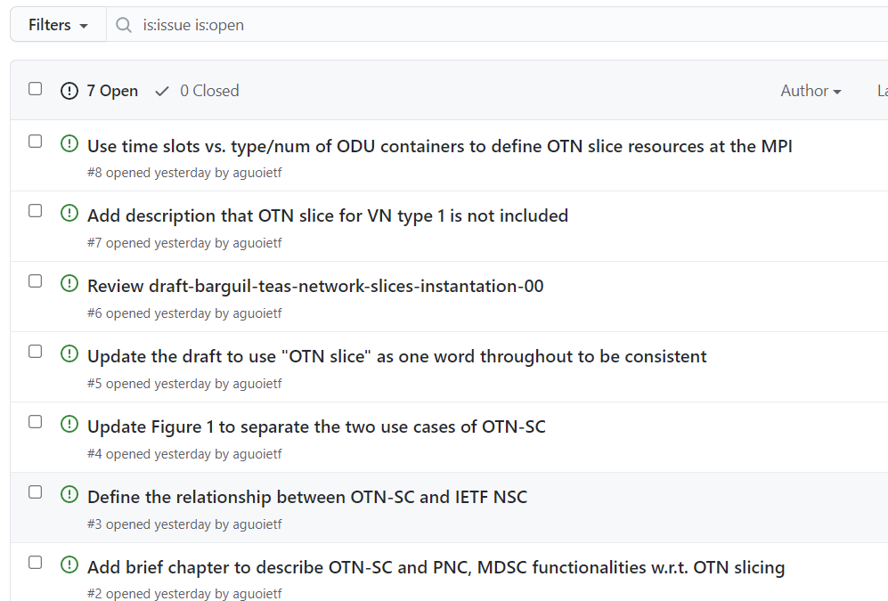
Issues - https://github.com/aguoietf/ietf-ccamp-yang-otn-slicing/issues

Slide 9
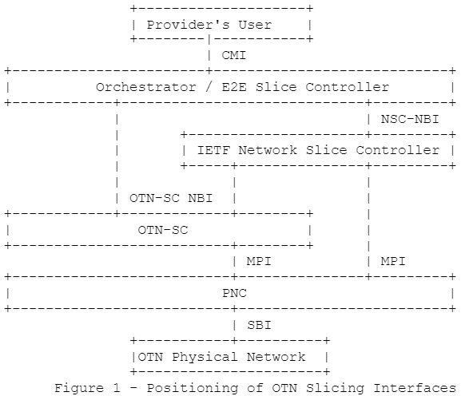
Functional Diagram of OTN-SC
Orchestrator/E2E SC
NSC NBI
IETF-NSC
OTN-SC NBI
OTN-SC
MPI
PNC
OLD
NEW

Slide 10
Scope of An OTN Slice
Single Domain
OTN Slice
Access Link
OTN Link
Access Link
CE
OTN PE
OTN PE
CE
End-to-end OTN Slice
Multi Domain
OTN Slice 1
OTN Slice 2
Access Link
OTN Link
OTN Border Node
Inter-domain OTN Link
OTN Border Node
OTN Link
Access Link
CE
OTN PE
OTN PE
CE
OTN Domain 1
OTN Domain 2

Slide 11
Multi-domain OTN-SC
OTN-SC
OTN-SC
OTN-SC
MPI
MPI
OTN-SC NBI
PNC
L-MDSC
OTN-SC
OTN-SC
MPI
MPI
PNC
PNC
PNC
PNC
Single Domain
Multi Domain Option 1
Multi Domain Option 2

